Slide 1
AffordAble Abodes Sdn Bhd
Empowering People to Fight Poverty

Slide 2
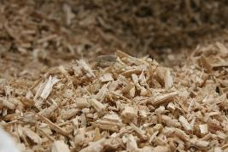
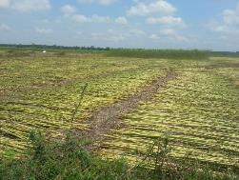
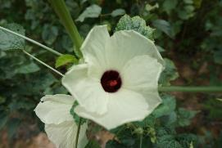
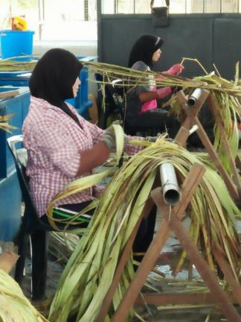
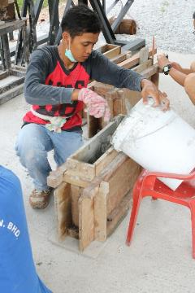
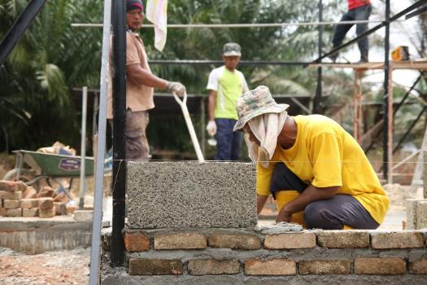
Affordable Abodes is a social enterprise that promotes the construction of affordable and sustainable low-cost housing for the less fortunate
We produce bio-composite building materials
made from Kenaf
Social Impact
And use an integrated value chain to create social impact
Sustainability
Economic
Development

Slide 3
Problem Definition – Conventional Building Materials
Cement – mining of limestone causes environmental damage
Steel (Rebars) - mining of metallic ores causes environmental damage
Reinforced Concrete – steel, cement, sand, granite, water
Bricks – removing valuable soil resources
Timber – habitat destruction
Total global steel output is more than 1.5 billion tonnes in 2018 (Worldsteel Association).
Total global cement production is more than 3.3 billion tonnes in 2018 (Statista Portal).
Steel industry generates 9% greenhouse gases
(1.8tonnes CO₂ emitted for every ton of steel produced)
Cement industry generates 5% greenhouse gases
(0.9tonnes CO₂ emitted for every ton of cement produced)
Cause of 14% greenhouse gases
Environmental damage
Non-renewable

Slide 4
A Solution
What role do office buildings play in keeping global warming below 2°C?
Consider this statistic:
The built environment is responsible for 40% of energy consumption and CO2 emissions.
Prioritise the design of workplaces that are environmentally friendly and sustainable. This is easier when designing a new-build from scratch where ‘green’ principles can be set as a strategic core.
Reference: Linkedin “4 ways your office could be more environmental friendly” – 11 March 2019

Slide 5
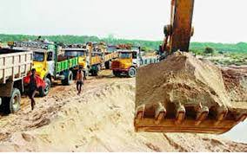

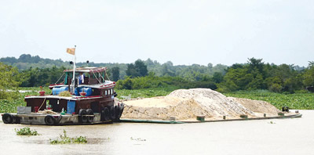
Kenafcrete® Biocomposite Renewable, Environmentally Sustainable building material
Does NOT contain SAND
Sand – escalating cost
Non-renewable resource
Sand mining
  depletes natural resources
  damages ecosystem; habitat destruction
  direct cause of erosion
  deaths

Slide 6
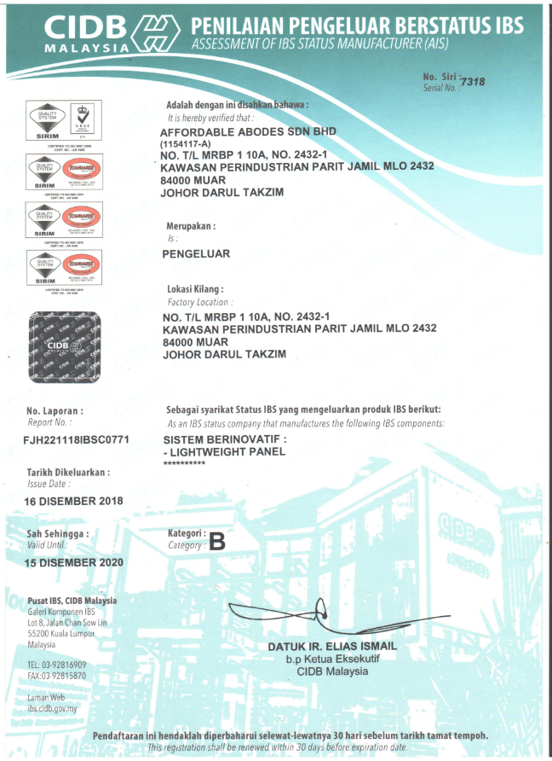
AffordAble Abodes Sdn Bhd – IBS status manufacturer
1st in Malaysia
Structural Wall Panel
High Strength (Safety)
Light Weight
Innovative Building System
Fast and Efficient

Slide 7
AffordAble Abodes Products
Definition: Kenafcrete® Structural Insulated Panel System (KSIP)
  Light Weight (70% lighter than brick or concrete walls)
  High Strength - Structural Grade for up to 2-storeys (Compressive load test single panel 50kN). Reinforced concrete & steel not required.
  CIDB - IBS (Industrialized Building System)
Key Selling Points
  Easier; Faster Installation (KSIP 5.4 m²/hr , Bricks 1 m²/hr)
  Fire Resistant (SIRIM test related to BOMBA requirements)
  Fully reusable – renovations. Simply unbolt panels.
  During fire testing internal temperature 1,000°C; external temperature never exceeded 34°C
Related matters (data drawn from hempcrete which bears similar properties to Kenafcrete®)
  Insulated Panels – Thermal & Acoustic (Mean Acoustic Absorption Coefficient 0.69 NRC)
  Superior thermal insulation properties (Pre-fabricated hemp wall panels U-value 0.13W/m2.K)
  Insect & Mould Resistant (John French, a leading Queensland and international entomologist, has tested Hempcrete in the Northern Territory and Queensland with no effect on the Hempcrete samples)

Slide 8
Kenafcrete® panels are first-in-class and pre-fabricated for use in structural applications
Materials: Kenafcrete® Bio-composite
Fillers: Upcycled Kenaf Core Bio-mass
Binders: Upcycled Industrial By-Products (lime, slag, fly ash, etc.)
Frame: Light Gauge Steel GS3560
Density: 500-550 kg / m³
40%
Cheaper to Install
70%
Lighter
97%
Recycled Materials
*vs. brick walls
*Compared to other prefab concrete panels
*Industrial and agricultural waste
Other Cost Savings: Installation time, labour costs, foundation and structural material costs

Slide 9
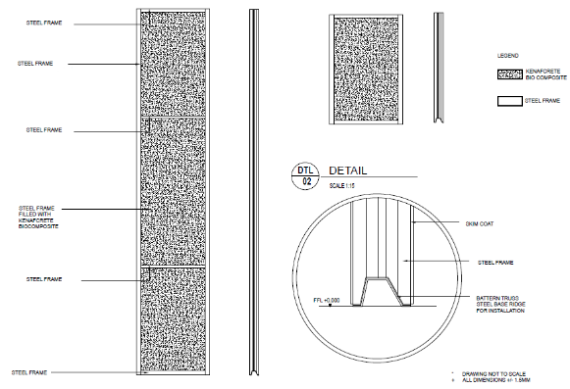
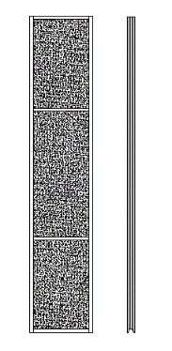
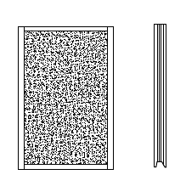
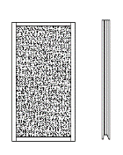
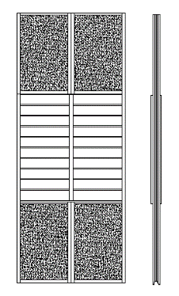
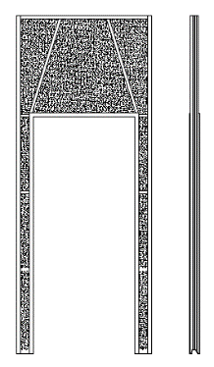

AffordAble offers Kenafcrete® Structural Insulated Panels, which are certified and safe for use in any building project!
Kenafcrete® Structural Insulated Panels
Kenafcrete® Products
KSW-30
(3000 x 600 x 73.5 mm)
KSW-12
(1200 x 600 x 73.5 mm)
KSW-09
(900 x 600 x 73.5 mm)
KSW-09 (x4): Window Panel
(3000 x 1200 x 73.5 mm)
KSD-30: Door Panel
(3000 x 1200 x 73.5 mm)
Fire Test and Hose Stream
Passed
Load Testing
Passed
Tests: | Fire test – 2 hours at 1000°C; Hose stream
Test Ref: Test Cert No. | BS 476 Part 22 1987 (non-loadbearing); ASTM E2226 FL000076
Testing Facility: | SIRIM QAS International Sdn Bhd
Tests: | Compressive load; Transverse load
Test Ref: Test Cert No. | ASTM E72 – 15, Clauses 9 & 11 2018CB1231
Testing Facility: | CREAM CIDB

Slide 10
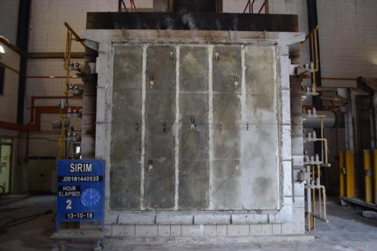
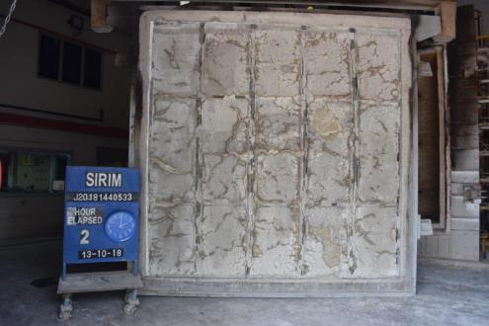
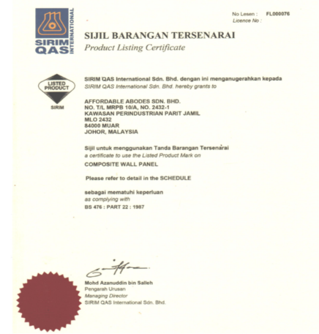
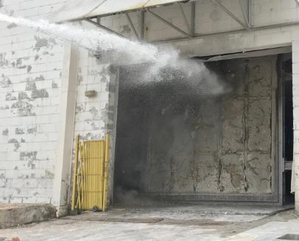
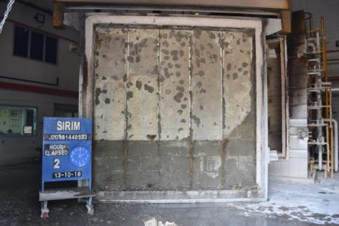
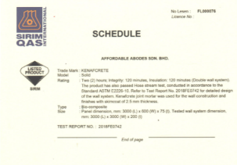
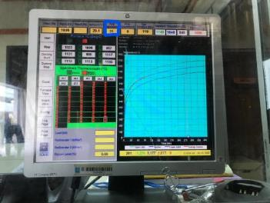
AffordAble offers Kenafcrete® Structural Insulated Panels, which are certified and safe for use in any building project!
Fire Test & Hose Stream Test – 13 Oct 2018
SIRIM Product Certificate
Internal:1000°C
External: 31°C
2 hours

Slide 11
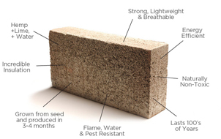
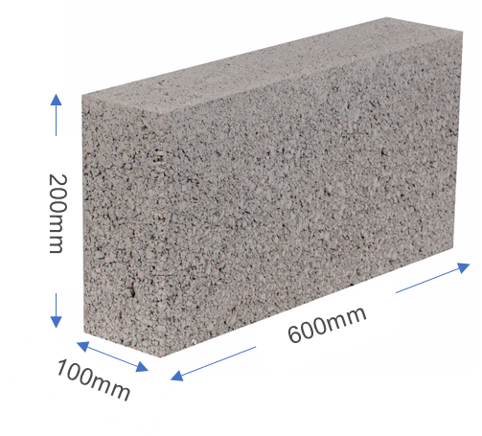
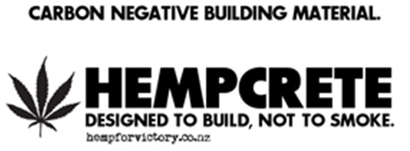
Kenafcrete® technology is essentially derived from Hempcrete. The following references are drawn from known sources of published hempcrete information.
KENAFCRETE

Slide 12
Thermal
Pre-fabricated hemp wall panels (U-value 0.13W/m2.K)
Thermal Performance - U-Values See Thermal Datasheet
300 mm wall gives 0.30 W/m2 .K
400 mm wall gives 0.22 W/m2 .K
500 mm wall gives 0.18 W/m2 .K
U-value (W/m2.K)
Wall Thickness (mm)

Slide 13
Acoustic
Mean Acoustic Absorption Coefficient 0.69 NRC
Testing carried out by the BRE on the Haverhill houses see www.projects.bre. co.uk/hemphomes/ showed that hemp lime construction met the acoustic requirements of the building regulations. Further ongoing research shows that Tradical Hemcrete has the ability to absorb up to 90% of air-born sound. This research is continuing in order to maximise the potential of Hemcrete to be used in sound-proofing applications.

Slide 14
Mold, Fungus Bacteria, Pests
DAMP-FREE (on mold)
It is “breathable” (vapour permeable) and hygroscopic: hempcrete walls and the lime or clay plaster finishes will passively “buffer” the levels of humidity inside the home, absorbing moisture from the air into the wall during times of high relative humidity and releasing it again when humidity levels drop. This eliminates condensation on the surface of the wall, preventing the conditions for damp spores to grow, and keeps internal humidity levels within the 40-60% range which inhibits the growth of viruses and bacteria. All of this is achieved without the need for mechanical ventilation systems.
CHEMICAL-FREE (on fire, rot, mold)
Because of the lime binder which coats every particle of hemp in the hempcrete mixture, hempcrete achieves good ratings for fire-, rot-, and pest-resistance, without the need for additional treatment with potentially harmful chemicals. The fact that the structural frame is set within the hempcrete wall allows for untreated softwood to be used, further reducing the need for chemicals in the home.
The presence of lime increases the pH and is known to control or even kill off fungus, bacteria and virus. It is a natural anti-microbial substance.

Slide 15

Is Hempcrete termite resistant?
Absolutely. John French, a leading Queensland and international entomologist, has tested Hempcrete in the Northern Territory and Queensland with no effect on the Hempcrete samples.
++++++++++++++++++++++++++++++++++++++++++++++++++++++++++++++++++++++++
References
Hempcrete as a Sustainable Building Material, Joseph Updike, South Dakota School of Mines and Technology
The Thermal Performance of Hempcrete, American Lime Technologies
Greencore Construction
Hemp Lime Technology, Tradical® Hemcrete® Information Downloads
Hydrated lime use in soils, Charmaine R Taylor

Slide 16
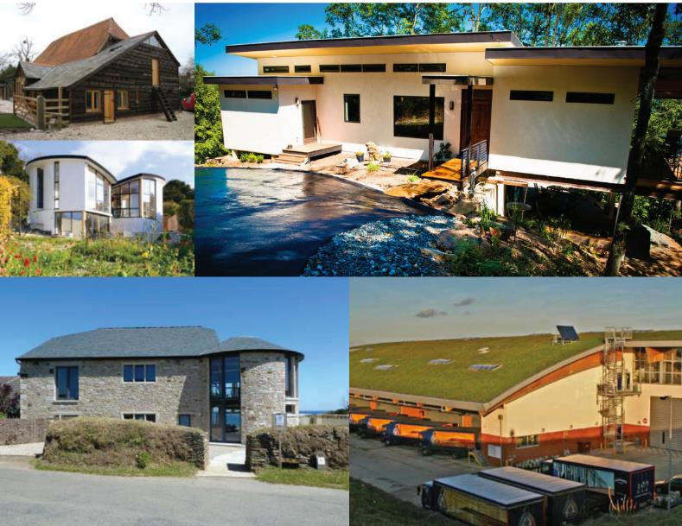
Hemp Builds, Old and New
Even though Europe has recently led in the designs and construction of hemp-based building materials, building with hemp is not new. The hempcrete design was likely modelled after a sixth-century bridge in southern France, which was built with hemp hurd and petrified lime.
Source: https://www.hempbizjournal.com/building-with-hemp-a-carbon-sequestering-energy-efficient-solution/

Slide 17
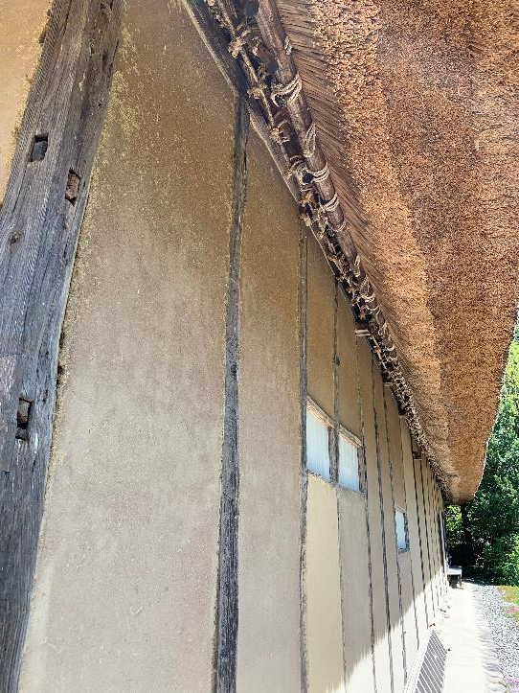
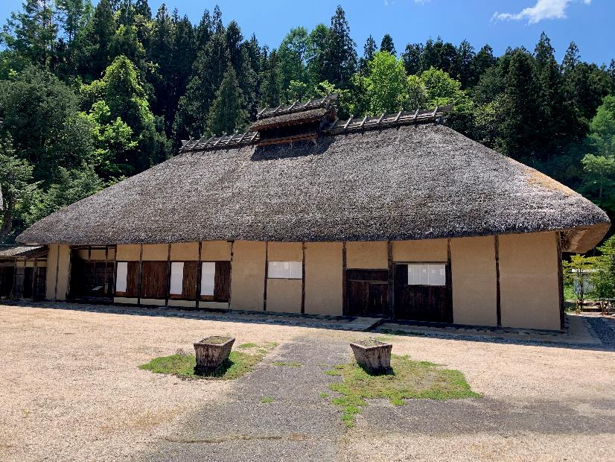
Oldest known hemp building – Japan (>320 years)
This historic hemp house in Nagano was built in 1698. It is now recognised as a Japanese national heritage site. It was left to the village by Mr. Nakamura, its former village chief who founded the Asa no Yakata hemp museum.

Slide 18
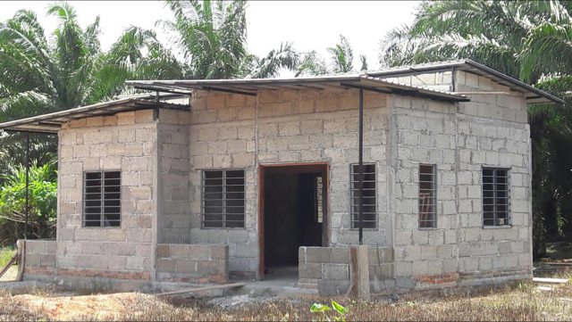
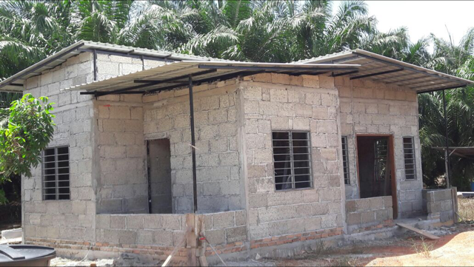
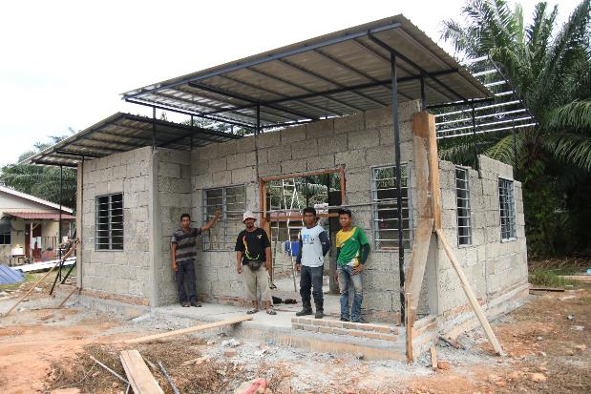
Kenafcrete® Pilot Project – Sungai Balang, Johor
Built in August 2016
Kept exposed to withstand the test of time & elements

Slide 19
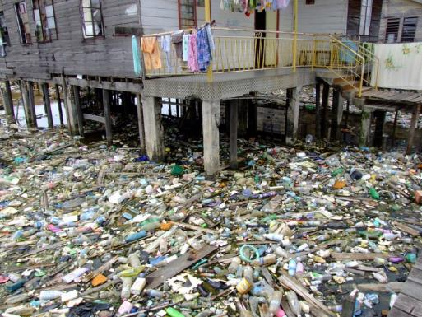
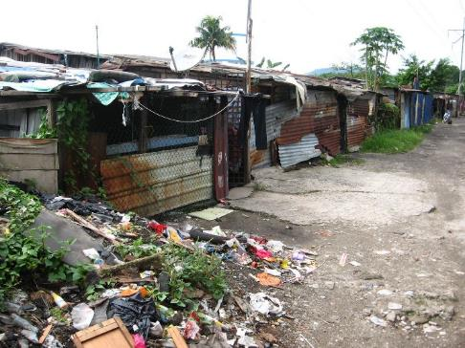
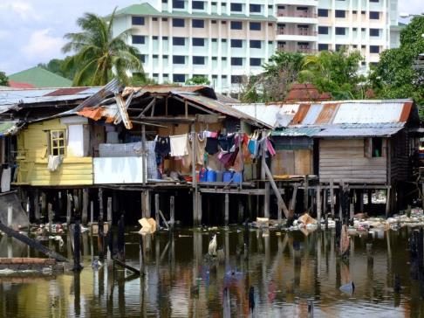
Product Strategy – Market Segmentation & Objective
Product Strategy – IDEAL FOR
  Low cost housing
  Schools
  Health Care Facilities
Market Segmentation
  1,000,000 low cost houses by 2020
Objective
  Build good quality low cost houses for
  needy communities
Current Conditions in Malaysia:
Low-cost housing is high-cost & poor-quality

Slide 20
14-Day Timeline for house construction (700 sqf)
Civil Works 4 days
Structural Works 2 days
Roofing Structure 2 days
M&E 3 days
Architectural Finishing 3 days
Total 14 days to complete
Day | Phase | Planned Schedule
 | Site Clearance | Completed
 | Mobilsation | Material Arrival on site in Advance
1 | Civil Works | Earth Works, Site Setting, Crusher Run, Ground Compaction
2 | Civil Works | Battery Piles / Septic System
3 | Civil Works | Foundations - LiB
4 | Structural Works | Walls / Door Frame Panels
5 | Structural Works | Walls / Door Frame Panels / Windows / Plumbing - waste water pipes
6 | Structural Works | Roofing System / Cast Floor Slab
7 | Structural Works | Roofing System / M&E installations / Floor Screeding / Wall Plastering
8 | Structural Works | Roofing System / M&E installations / Floor Screeding / Wall Plastering
9 | Architectural Works | Roofing System / Water Tank / Wall Plastering / Sanitary ware / Tiling
10 | Architectural Works | Wall Plastering / Tiling
11 | Architectural Works | Tile Grouting
12 | Architectural Works | Painting
13 | Architectural Works | Painting
14 | Architectural Works | Touch Up / Handover

Slide 21
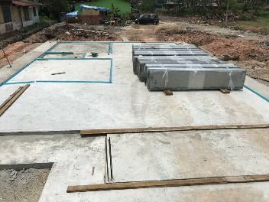
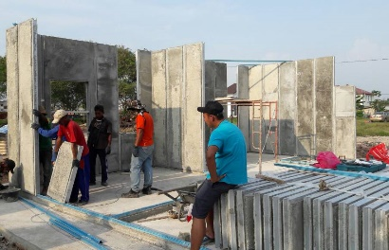
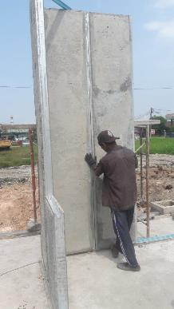
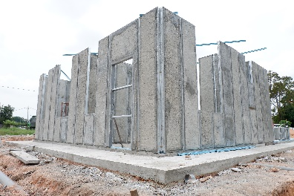
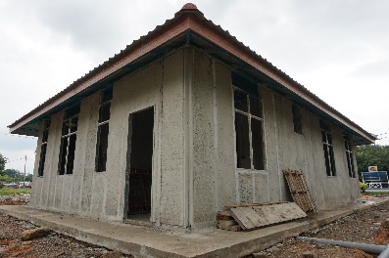
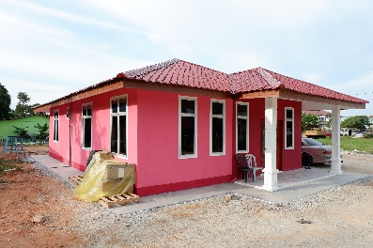
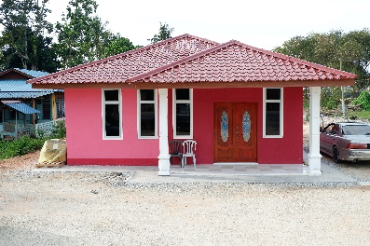
Project Showcase – Kenafcrete® Biocomposite Panel House
Muar, Johor, Malaysia
April 2018
Social Impact:
Charitable project to replace house destroyed by fire
Layout:
3 bedroom, 1 bathroom
Size:
1000 ft²
Products:
KCW-30 & KSW-09 Kenafcrete® panels

Slide 22
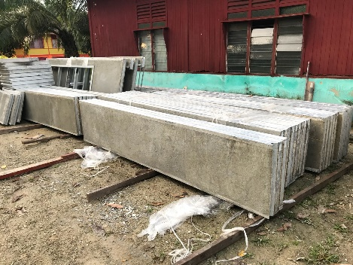
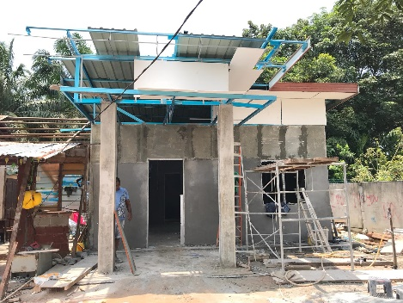
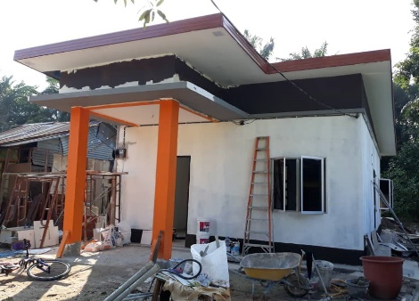
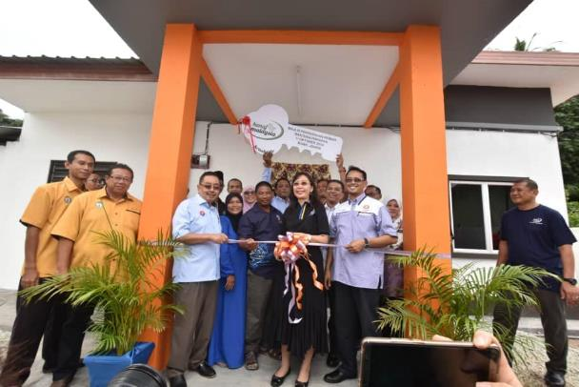
Project Showcase – Kenafcrete® Biocomposite Panel House
Tanjung Gading, Johor, Malaysia
Sept 2018
Social Impact:
“Community Aid” housing for disabled man and his family
Layout:
3 bedroom, 1 bathroom
Size:
600 ft² + 100 ft² veranda
Products:
KSW-30 & KSW-09 Kenafcrete® panels

Slide 23
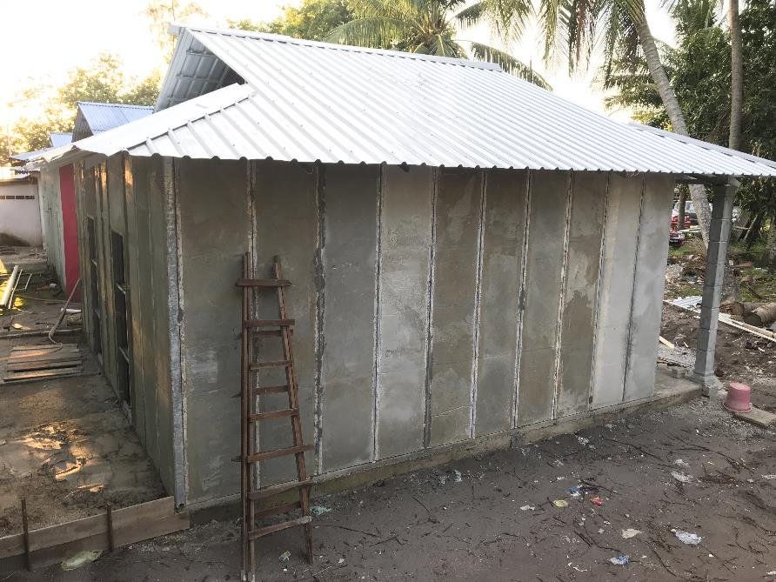
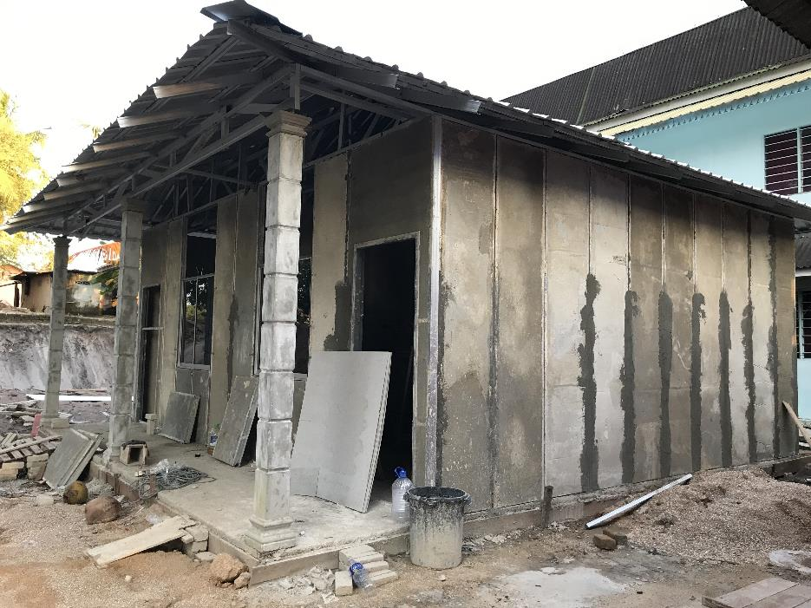
Project Showcase – Kenafcrete® Biocomposite Panel House Pengkalan Balak, Malacca
Nov 2018

Slide 24
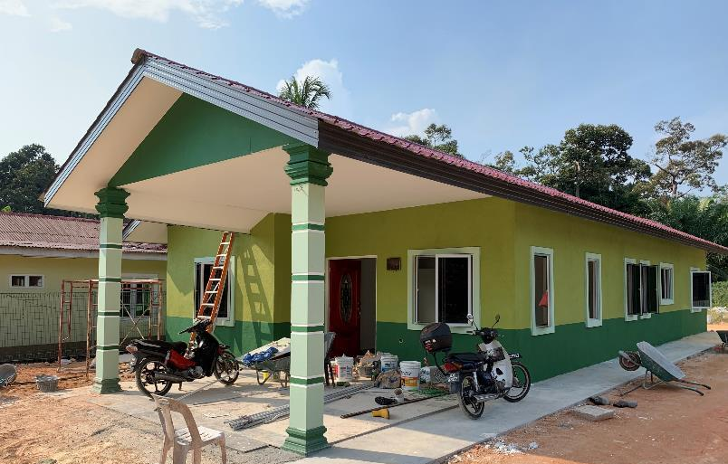
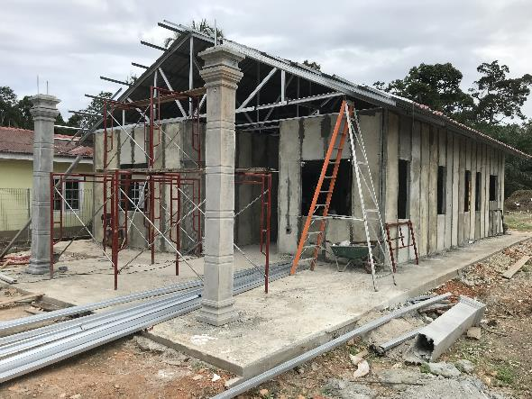
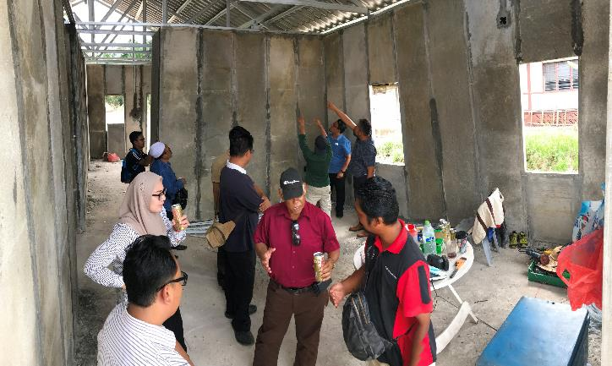

Project Showcase – Kenafcrete® Biocomposite Panel House Parit Lubok, Johor
Jan 2019

Slide 25




Project Showcase – Kenafcrete® Biocomposite Panel House
USM, Penang
Mar 2019

Slide 26




AASB has been featured in 2 major publications and is expecting 2 more in early 2019
Q1-18 | Q2-18 | Q3-18 | Q4-18 | Q1-19
Publications
Jan 2018:
Salt & Light
Nov 2018:
Responsible Business 3.0 (The Edge Markets)
Q1 2018:
2 expected publications

Slide 27
videos
Selamat Pagi Malaysia
  SPM 2019 – KENAFCRETE [15 APRIL 2019]
  https://youtu.be/svgmP0AClhE
AffordAble Abodes Kenaf Biocomposite House
  https://youtu.be/5Zqe05nVago
Kenafcrete IBS SIP House in 18 days:
  https://youtu.be/d5oUbrFwEzY

